Slide 1
Finishing Your Career Portfolio
on careerzone.ny.gov

Slide 2
Click on My Portfolio

Slide 3
Log in with your information -suggested password: eagles1

Slide 4
Success!!!

Slide 5
Access the Resume Builder

Slide 6
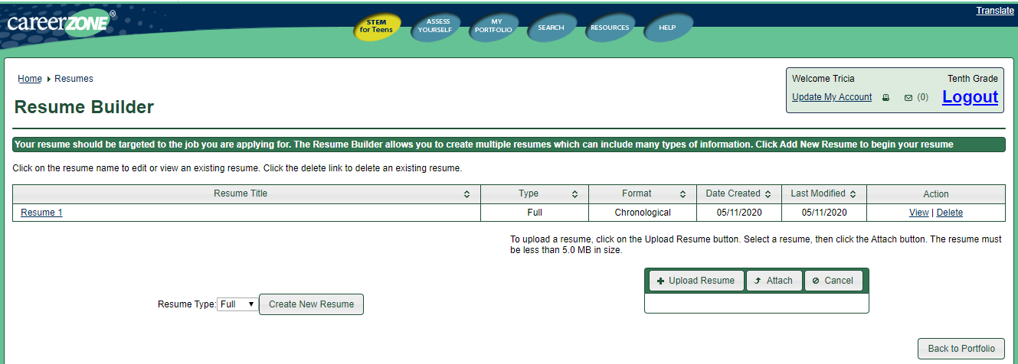
Resume Builder – Choose Resume 1

Slide 7
Resume Builder – Intro. Tab
This tab allows you to choose the resume name and format.
You may also choose to use your default contact info (FCS address) or alternative personal contact information.

Slide 8
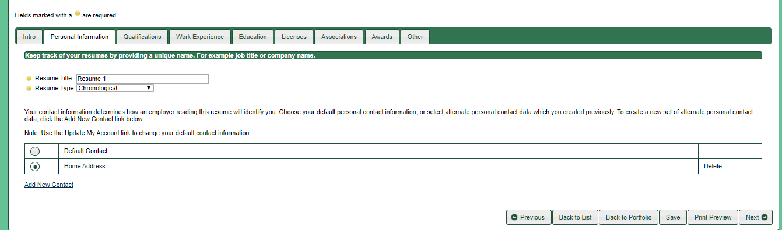
Resume Builder – Personal Info. Tab - choose Home Address, not default contact - @ the bottom click next

Slide 9
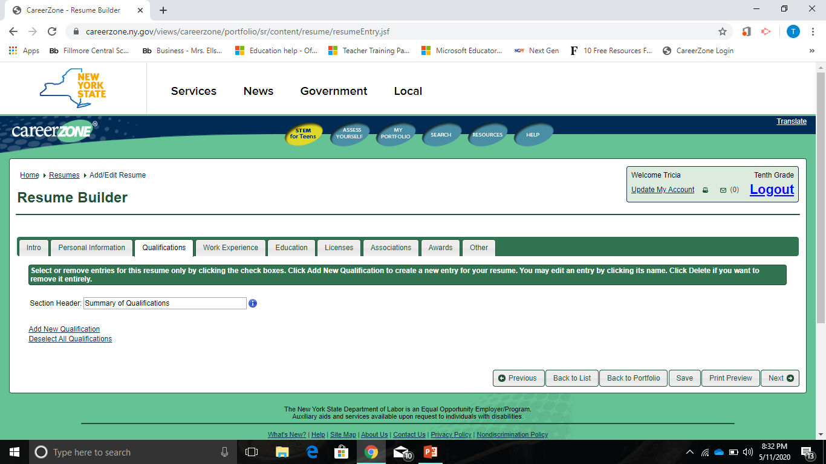
You may skip the Qualifications Tab for Now
Click Next
at the bottom right
This will move you on to Work Experience

Slide 10
Work Experience
At the bottom left: Add New Work Experience
Look at your Personal Data Form
Add in all of your information

Slide 11
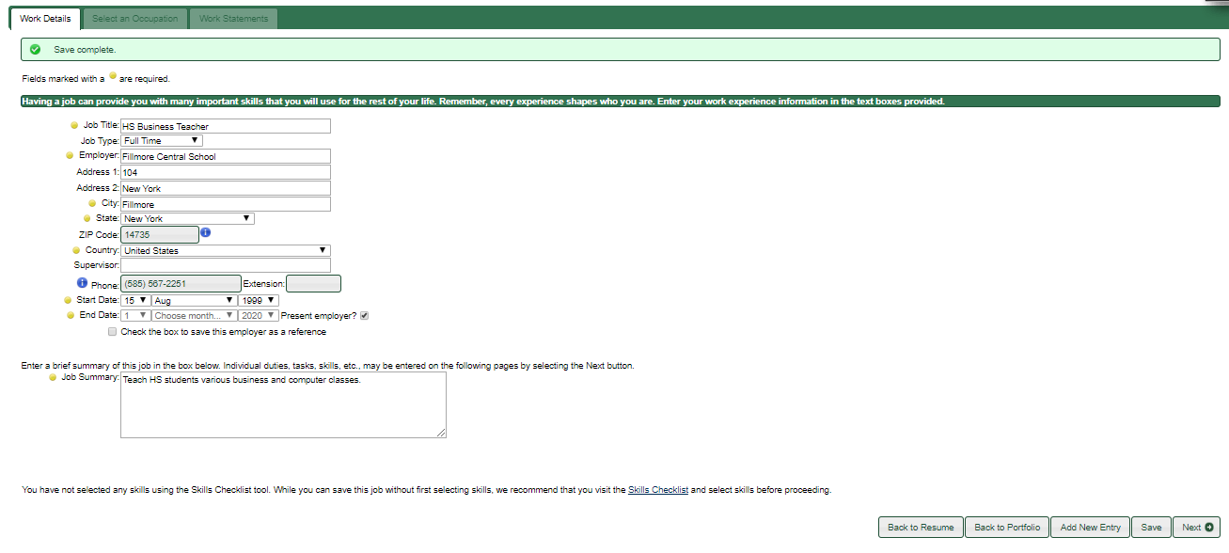
Work Experience
Add in as much information as you can.
Make sure to fill in all of the required information at the yellow bullets.
Add Work Experience for each job you have had (paid or unpaid).
Keep saving every time you input information.
Click Next…

Slide 12
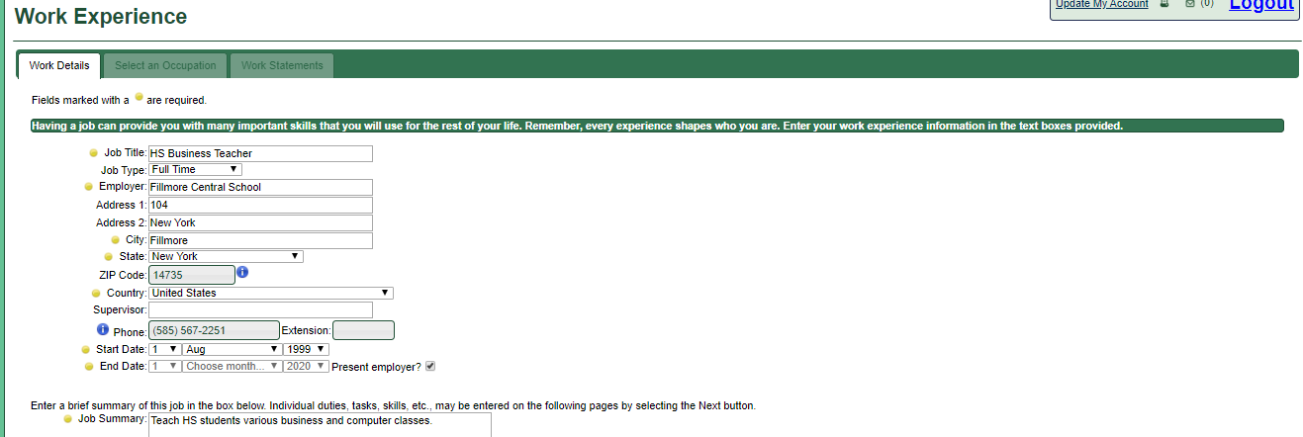
Work Experience - Work Details -Input all information marked with Yellow Bullets to the best of your ability. -Click SAVE, then NEXT

Slide 13
Work Experience - Work Details Continued - This is my information for MY 2nd job. - Input your data for a 2nd job if you have one at yellow bullets. - Click SAVE, then NEXT

Slide 14
Licenses Tab - Unselect the checkmark. - Skip the rest of this page. - Click save and then next.

Slide 15
Associations Tab - You can list any clubs you are in or just skip this section.
- You can add another club by the Add New Entry button.
- You only need to add the name of the Club at the yellow bullet and save.

Slide 16
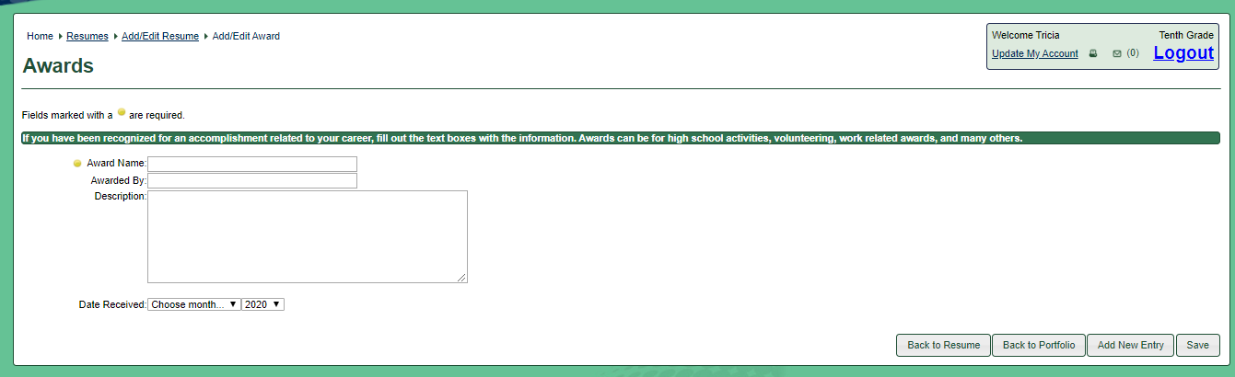
Awards Tab - Click the Add New Award - Add Award Title and Year Obtained. - Click on Add New Award to add more. - Click Save when done.

Slide 17
Education Tab - Click “Add New Education”

Slide 18
Education History - Input all information marked with Yellow Bullets to the best of your ability. - At Degree Type: Expected Date of Graduation: 20?? -Click SAVE, then Back to Resume

Slide 19
Other Tab - Add your skills and abilities here. - For example: your words per minute, computer software you use, etc. - Save, then click on Back to Portfolio. - Next week we will be working with Print Preview.

